Slide 1
Fundamentals of Databases Level 4
Entity Relationship Modelling
Lecture 2

Slide 2
Overview
Conceptual Analysis
Data Modelling - Entity Relationship Diagrams

Slide 3
Entity Relationship Diagram
Entities and their relationships shown on an Model - CASE tools e.g. SEMANTICPAD

Slide 4
Entity Relationship Diagram
Entity (Type) something the system needs to store data about
Identify Candidate Entities (possible entities)
Ensure all 4 Tests of an entity type apply
Test one | The object should be of importance in the system being studied
Test two | There should be data attributes that can be associated with the entity
Test three | There should be more than one occurrence of this entity type
Test four | It should not be an attribute of an entity

Slide 5
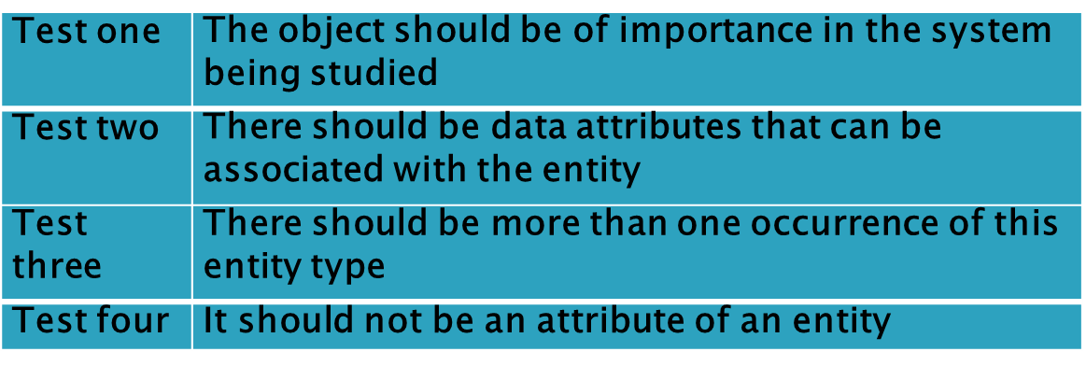
Identify Entity Types
Formula One example
There are 11 F1 Teams e.g. Mercedes, McLaren, Ferrari, Williams etc. which engage drivers to take part in the F1 World Championship. Each F1 Team is based in one country e.g. Williams and McLaren are British, Mercedes is German etc.. F1 Teams contract drivers to race for them in the 20 races which take place each year.

Slide 6
Entity Type Definition
Entity Type | Attributes | Entity Description
TEAM | Team name, Full Teamname, Base, First Year, Power unit | A support team in the Formula One Championship
DRIVER | Driver no, Surname, Firstnames, Date of birth, country, place of birth | A driver contracted to drive in the Formula One Championship
RACE | Race Number, track name, race year, race date | A date at an approved location at which the Formula One Championship takes place

Slide 7
Entity Relationships
Identify the ENTITY TYPES then model the RELATIONSHIPS between them
TEAMs contract DRIVERs
DRIVERs compete in RACEs
Decide on the CARDINALITY – how one occurrence in the first entity is related to occurrence(s) in the other entity e.g.
Each TEAM contracts many DRIVERs
Relationships have 2 directions, both sides must be modelled e.g.
One to many, many to many, one to one

Slide 8
Identify Entity Types
Formula One example
There are 11 F1 Teams e.g. Mercedes, McLaren, Ferrari, Williams etc. which engage drivers to take part in the F1 World Championship e.g. both Hamilton and Rosberg are contracted to Mercedes, they can have one contract at a time. Each F1 Team is based in one country e.g. Williams and McLaren are British, Mercedes is German etc.. F1 Teams contract drivers to race for them in the 20 races which take place each year.

Slide 9
Entity Relationships
ENTITY TYPES their RELATIONSHIPS and their CARDINALITY e.g. One to many, many to many, one to one
TEAM, DRIVER and RACE
A TEAM contracts one or many DRIVERs
A DRIVER is contracted to one TEAM
A DRIVER competes in one or many RACEs
A RACE is competed in by one or many DRIVERs
This can now be represented on an Entity Relationship Diagram

Slide 10
Entity Relationships
ENTITY TYPES their RELATIONSHIPS and their CARDINALITY e.g. One to many (1:M), many to many(M:N), one to one (1:1)
TEAM, DRIVER and RACE
A TEAM contracts one or many DRIVERs
A DRIVER is contracted to one TEAM
A DRIVER competes in one or many RACEs
A RACE is competed in by one or many DRIVERs
This can now be represented on an Entity Relationship Diagram
1:M

Slide 11
Entity Relationships
ENTITY TYPES their RELATIONSHIPS and their CARDINALITY e.g. One to many (1:M), many to many(M:N), one to one (1:1)
TEAM, DRIVER and RACE
A TEAM contracts one or many DRIVERs
A DRIVER is contracted to one TEAM
A DRIVER competes in one or many RACEs
A RACE is competed in by one or many DRIVERs
This gives us 2 relationships and can now be represented on an Entity Relationship Diagram
1:m
m:n

Slide 12
CARDINALITY and NAMING of RELATIONSHIPS
A One to many (1:m) relationship
An TEAM contracts one or many DRIVERS
A DRIVER is contracted to one TEAM
A many to many (m:n) relationship
A DRIVER takes part in one or many RACES
A RACE is competed in by one or many DRIVERS

Slide 13
OPTIONALITY IN RELATIONSHIPS
Membership of a relationship isn’t always mandatory:
consider an event where independent drivers can compete
A one to many (1:M) relationship with optionality
The circle can be viewed as the letter O for optionality but is best considered as a zero occurrence.
Notes:
A zero occurrence implies optionality.

Slide 14
Cardinality of Other relationships
1:1 relationships
A one to one relationship without optionality

Slide 15
Many to Many Relationships
Identifying relationships that have data associated with them
Many to many (M:N) relationship between DRIVER and RACE
What if the relationship has data associated with it?
What data might be associated in this relationship?

Slide 16
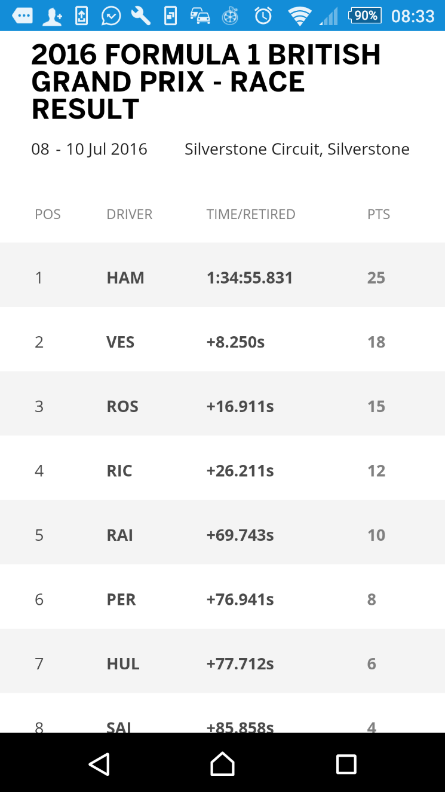
Many to Many Relationships with data associated with them
DRIVER and RACE
relationship,
what about
race outcomes?

Slide 17
Many to Many Relationships with data associated with them
DRIVER and RACE
relationship,
what about
race outcomes?

Slide 18
Resolving Many to Many relationships
Where can we store the data position, time and points associated with the relationship between DRIVER and RACE?
In DRIVER?
Entity Type | Attributes | Entity Description
DRIVER | Driver no, Surname, First names, Date of birth, country, place of birth, | A driver contracted to drive in the Formula One Championship
RACE | Race Number, track name, race year, race date | A date at an approved location at which the Formula One Championship takes place

Slide 19
Resolving Many to Many relationships
Where can we store the data position, time and points associated with the relationship between DRIVER and RACE?
In DRIVER?
Entity Type | Attributes | Entity Description
DRIVER | Driver no, Surname, First names, Date of birth, country, place of birth, position, time, points | A driver contracted to drive in the Formula One Championship
RACE | Race Number, track name, race year, race date | A date at an approved location at which the Formula One Championship takes place
but which race is it? X

Slide 20
Resolving Many to Many relationships
Where can we store the data position, time and points associated with the relationship between DRIVER and RACE?
In RACE?
Entity Type | Attributes | Entity Description
DRIVER | Driver no, Surname, First names, Date of birth, country, place of birth, | A driver contracted to drive in the Formula One Championship
RACE | Race Number, track name, race year, race date | A date at an approved location at which the Formula One Championship takes place

Slide 21
Resolving Many to Many relationships
Where can we store the data position, time and points associated with the relationship between DRIVER and RACE?
In RACE?
Entity Type | Attributes | Entity Description
DRIVER | Driver no, Surname, First names, Date of birth, country, place of birth, | A driver contracted to drive in the Formula One Championship
RACE | Race Number, track name, race year, race date, position, time, points | A date at an approved location at which the Formula One Championship takes place
but which DRIVER is it? X

Slide 22
Resolving Many to Many relationships
Where can we store the data position, time and points associated with the relationship in DRIVER or in RACE?
We need a new entity - RACERESULT
Entity Type | Attributes | Entity Description
DRIVER | Driver no, Surname, First names, Date of birth, country, place of birth | A driver contracted to drive in the Formula One Championship
RACE | Race Number, track name, race year, race date | A date at an approved location at which the Formula One Championship takes place

Slide 23
Resolving Many to Many Relationships
A many to many relationship between A and B can always be resolved by adding a 3rd Entity Type C as below.

Slide 24
We have a Many to Many(M:N) Relationship now

Slide 25
Becomes

Slide 26
Entity Type | Attributes | Entity Description
TEAM | Team name, Full Team name, Base, First Year, Power unit | A support team in the Formula One Championship
DRIVER | Driver no, Surname, First names, Date of birth, country, place of birth | A driver contracted to drive in the Formula One Championship
RACE | Race Number, track name, race year, race date | A date at an approved location at which the Formula One Championship takes place
RACERESULT | Race Number, Driver no, position, time, points | The outcome of each race for each driver
NOTE - two identifying attributes are needed - one from DRIVER and one from RACE. More next week!

Slide 27
Summary
Conceptual Analysis - Data Modelling (continued)
Entity Relationship Diagrams
Relationships modelled accurately
Label correctly, add cardinality and optionality
Read relationships in both directions to check correct
Resolving M:N relationships which hold data
Next week Logical Design

